Slide 1

FPT University
Android programMing
Lesson 21
Version 1.0

Slide 2
Agenda
Printing with the Android Printing Framework
Web Content Printing
Custom Document Printing

Slide 3
Android Printing Framework
With the introduction of the Android 4.4 KitKat release, it became possible to print content from within Android applications
Printing framework consists of a Print Manager and a number of print service plugins. It is the of the Print Manager to handle the print requests from applications on the device and to interact with the print service plugins that are installed on the device, thereby ensuring that print requests are fulfilled
By default, many Android devices have print service plugins installed to enable printing using the Google Cloud Print and Google Drive services.

Slide 4
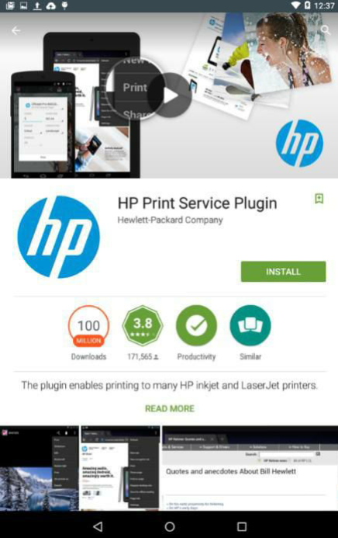
Android Printing Framework
The Print Service Plugins The purpose of the Print Service plugins is to enable applications to print to compatible printers that are visible to the Android device via a local area wireless network or Bluetooth.

Slide 5
Android Printing Framework
Google Cloud Print
Google Cloud Print is a service provided by Google that enables you to print content onto your own printer over the web from anywhere with internet connectivity.
Google Cloud Print supports a wide range of devices and printer models in the form of both Cloud Ready and Classic printers.
https://www.google.com/cloudprint/learn/printers.html

Slide 6
Android Printing Framework
To set up Google Cloud Print, visit the following web page and login using the same Google account ID that you use when logging in to your Android devices: https://www.google.com/cloudprint/learn/index.html
Once printers have been added to your Google Cloud Print account, they will be listed as printer destination options when you print from within Android applications on your devices.

Slide 7
Android Printing Framework
Printing to Google Drive In addition to supporting physical printers, it is also possible to save printed output to your Google Drive account. When printing from a device, select the Save to Google Drive option in the printing panel.

Slide 8
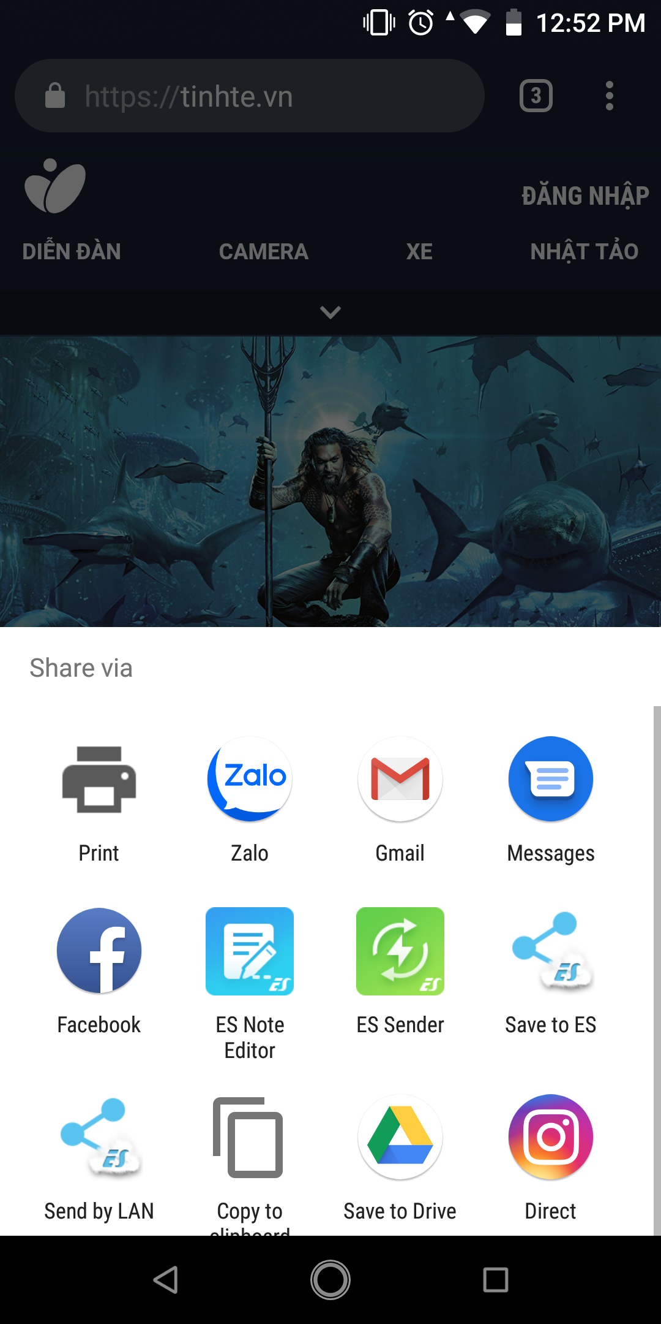
Android Printing Framework
Printing from Android Devices A number of applications bundled with Android now include print option

Slide 9
Android Printing Framework
Options for Building Print Support into Android Apps
Image Printing
Printing HTML Content
Printing a Custom Document

Slide 10

Web Content Printing
Creating the HTML Printing Example Application
Google recommends that applications which provide the ability to print content do so by placing the print option in the Overflow menu. So that we using basic activity for example.

Slide 11
Web Content Printing
Adding permission
<uses-permission android:name="android.permission.INTERNET"/>

Slide 12
Web Content Printing
Loading the web page
webView = findViewById(R.id.webView); webView.getSettings().getJavaScriptEnabled(); webView.setWebViewClient(new WebViewClient()); webView.loadUrl("https://developer.android.com");

Slide 13
Web Content Printing
Adding the Print Menu Option
<menu xmlns:android="http://schemas.android.com/apk/res/android" xmlns:app="http://schemas.android.com/apk/res-auto" xmlns:tools="http://schemas.android.com/tools" tools:context="com.example.fu.myapplication.MainActivity"> <item android:id="@+id/action_settings" android:orderInCategory="100" android:title="@string/action_settings" app:showAsAction="never" /> <item android:id="@+id/action_print" android:orderInCategory="101" android:title="Print" app:showAsAction="never" /> </menu>

Slide 14
Web Content Printing
Handle on menu item selected
@Override public boolean onOptionsItemSelected(MenuItem item) { int id = item.getItemId(); //noinspection SimplifiableIfStatement if (id == R.id.action_settings) { return true; } if (id == R.id.action_print) { createWebPrintJob(webView); return true; } return super.onOptionsItemSelected(item); }

Slide 15
Web Content Printing
Printing Job
private void createWebPrintJob(WebView webView) { PrintManager printManager = (PrintManager) this.getSystemService(PRINT_SERVICE); PrintDocumentAdapter adapter = webView.createPrintDocumentAdapter("Mydocument"); String jobName = getString(R.string.app_name) + " Print test"; printManager.print(jobName, adapter, new PrintAttributes.Builder().build()); }

Slide 16
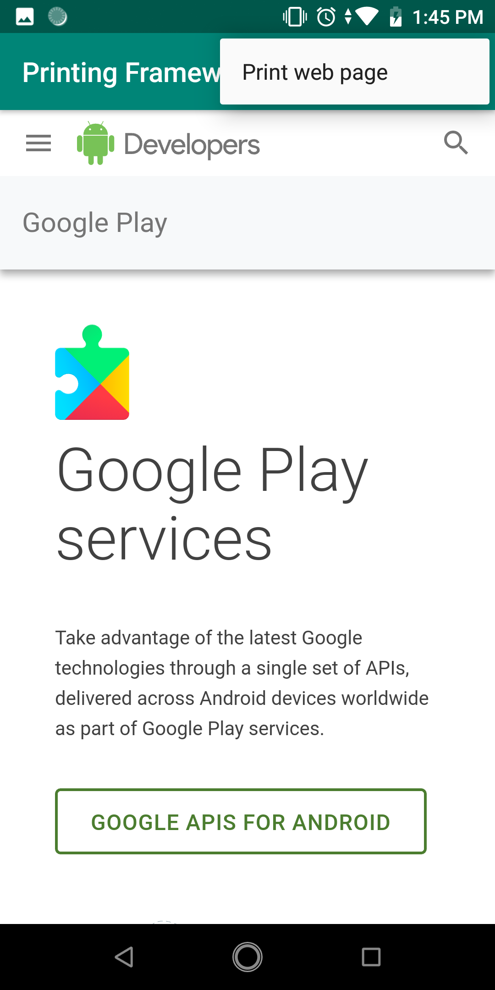
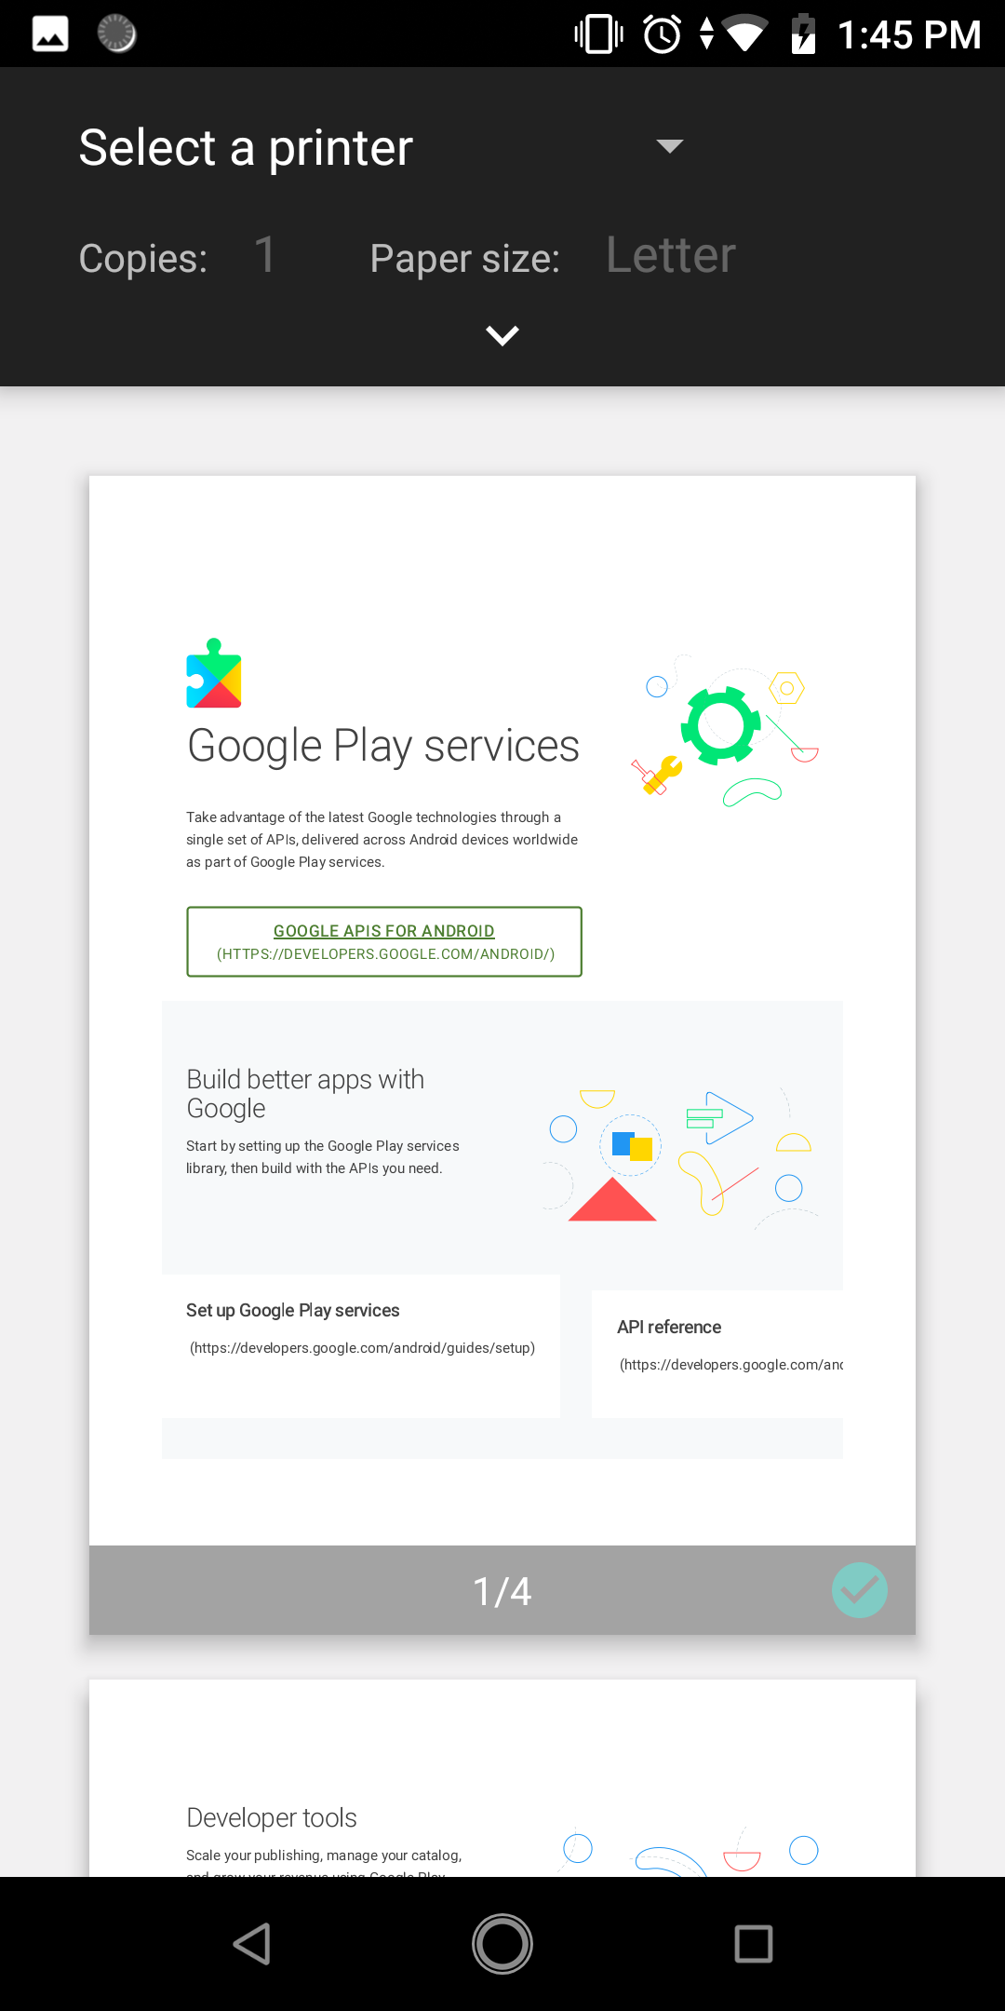
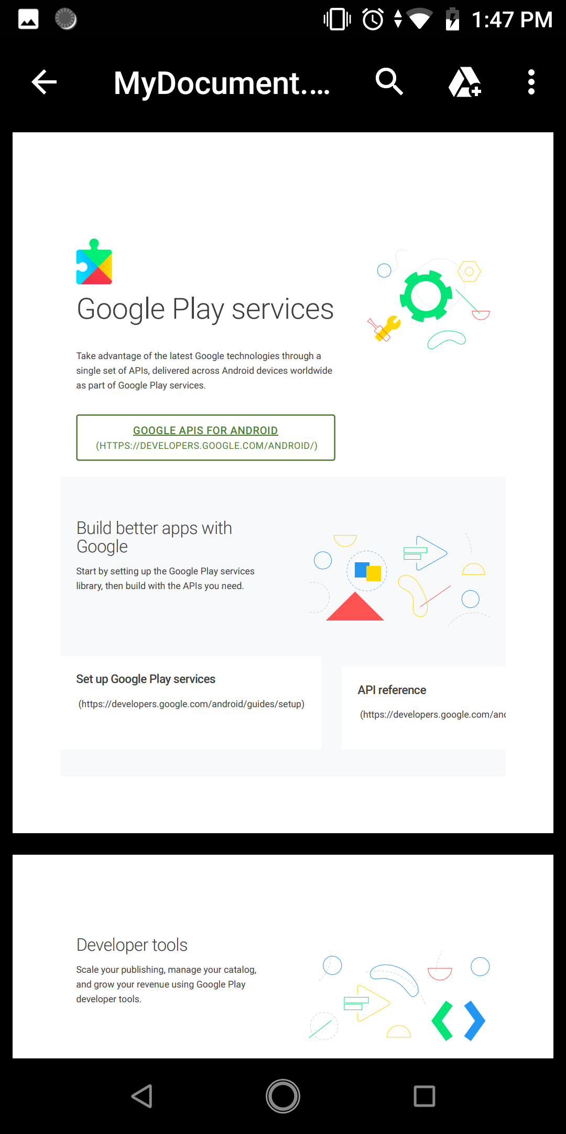
Web Content Printing
Testing application

Slide 17
Overview of Custom Document Printing
Custom document printing uses canvases to represent the pages of the document to be printed. The application draws the content to be printed onto these canvases in the form of shapes, colors, text and images

Slide 18
Custom Document Printing
Custom Print Adapters
The role of the print adapter is to provide the Printing framework with the content to be printed, and to ensure that it is formatted correctly for the user’s chosen preferences
Custom print adapters are created by sub-classing the PrintDocumentAdapter class and overriding a set of callback methods within that class which will be called by the Printing framework at various stages in the print process.

Slide 19
Custom Document Printing
Callback methods of Custom Print Adapter
onStart()
onLayout()
onWrite()
onFinish()
Notes:
· onStart() – This method is called when the printing process begins and is provided so that the application code has an opportunity to perform any necessary tasks in preparation for creating the print job. Implementation of this method within the PrintDocumentAdapter sub-class is optional. · onLayout() – This callback method is called after the call to the onStart() method and then again each time the user makes changes to the print settings (such as changing the orientation, paper size or color settings). This method should adapt the content and layout where necessary to accommodate these changes. Once these changes are completed, the method must return the number of pages to be printed. Implementation of the onLayout() method within the PrintDocumentAdapter sub-class is mandatory. · onWrite() – This method is called after each call to onLayout() and is responsible for rendering the content on the canvases of the pages to be printed. Amongst other arguments, this method is passed a file descriptor to which the resulting PDF document must be written once rendering is complete. A call is then made to the onWriteFinished() callback method passing through an argument containing information about the page ranges to be printed. Implementation of the onWrite() method within the PrintDocumentAdapter sub-class is mandatory. · onFinish() – An optional method which, if implemented, is called once by the Printing framework when the printing process is completed, thereby providing the application the opportunity to perform any clean-up operations that may be necessary

Slide 20
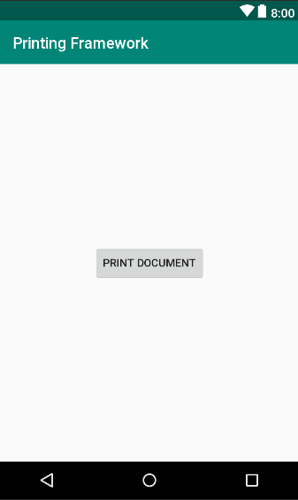
Custom Document Printing
Custom Document Printing Project

Slide 21
Custom Document Printing
Creating the Custom Print Adapter
public class MyPrintDocumentAdapter extends PrintDocumentAdapter { @Override public void onLayout(PrintAttributes oldAttributes, PrintAttributes newAttributes, CancellationSignal cancellationSignal, LayoutResultCallback callback, Bundle extras) { } @Override public void onWrite(PageRange[] pages, ParcelFileDescriptor destination, CancellationSignal cancellationSignal, WriteResultCallback callback) { } }

Slide 22
Custom Document Printing
Adding some global variables
public class MyPrintDocumentAdapter
extends PrintDocumentAdapter { Context context; private int pageWith; private int pageHeight; private PdfDocument document; public int totalPages = 4;
......
}

Slide 23
Custom Document Printing
Implement onLayout() method
document = new PrintedPdfDocument(context, newAttributes); pageHeight = newAttributes.getMediaSize().getHeightMils()/1000*72; pageWith = newAttributes.getMediaSize().getWidthMils()/1000*72; if(cancellationSignal.isCanceled()){ callback.onLayoutCancelled(); return; } if(totalPages>0){ PrintDocumentInfo.Builder builder = new PrintDocumentInfo .Builder("print_output.pdf") .setContentType(PrintDocumentInfo.CONTENT_TYPE_DOCUMENT) .setPageCount(totalPages); PrintDocumentInfo info = builder.build(); callback.onLayoutFinished(info, true); } else { callback.onLayoutFailed("Pages count is zero"); }

Slide 24
Custom Document Printing
Implementing the onWrite() Method
for (int i = 0; i < totalPages; i++) { if(pageInRange(pages, i)){ PdfDocument.PageInfo pageInfo = new PdfDocument. PageInfo.Builder(pageWith, pageHeight,i).create(); PdfDocument.Page page = document.startPage(pageInfo); if(cancellationSignal.isCanceled()){ callback.onWriteCancelled(); document.close(); document = null; return; } drawPage(page, i); document.finishPage(page); } } try { document.writeTo(new FileOutputStream (destination.getFileDescriptor())); }catch (IOException e){ callback.onWriteFailed(e.getMessage()); return; } finally { document.close(); document = null; } callback.onWriteFinished(pages);

Slide 25
Custom Document Printing
Checking a Page is in Range
private boolean pageInRange(PageRange[] pages, int page) { for (int i = 0; i < pages.length; i++) { if(page>=pages[i].getStart() && page <= pages[i].getEnd()) return true; } return false; }

Slide 26
Custom Document Printing
Drawing the Content on the Page Canvas
private void drawPage(PdfDocument.Page page, int pageNumber) { Canvas canvas = page.getCanvas(); pageNumber++; int titleBaseline = 72; int leftMargin = 50; Paint paint = new Paint(); paint.setColor(Color.BLACK); paint.setTextSize(14); canvas.drawText("This is some test content to verify
that custom document printing works", leftMargin,titleBaseline + 35, paint); if(pageNumber % 2 ==0) paint.setColor(Color.RED); else paint.setColor(Color.GREEN); PdfDocument.PageInfo pageInfo= page.getInfo(); canvas.drawCircle(pageInfo.getPageWidth()/2, pageInfo.getPageHeight()/2,150, paint); }

Slide 27
Custom Document Printing
Starting the Print Job
public void printDocumentClick(View view) { PrintManager printManager =
(PrintManager) this.getSystemService(PRINT_SERVICE); String jobName = this.getString(R.string.app_name) + " Document"; printManager.print(jobName, new MyPrintDocumentAdapter(this), null); }

Slide 28
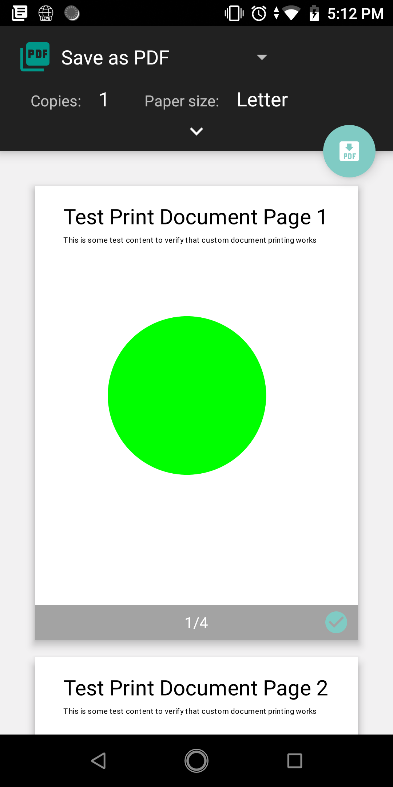
Custom Document Printing
Testing application

Slide 29

End of Lesson 21

Slide 30
Thank you!

